Slide 1
TTC - Mestrado em Microbiologia APLICADA
IE - MESTRADO EM MATEMÁTICA APLICADA ECONOMIA & GESTÃO
ITT – Engenharia Biomédica e Biofísica
IE - OPCIONAL PARA 2º CICLO
AULA 2
9 MARÇO 2020
FCUL – 2019/2020
Helena Vieira
Copyright ©

Slide 2
Summary
Gestão de expectativas
Emprego versus negócio.
Empreendedorismo versus TTC. Inovação Versus Empreender
A valorização económica do conhecimento técnico-científico.
A indústria versus a Universidade.
Conceitos e definições base.
Ferramentas de gestão e técnico-científicas.
Soft skills e vantagem no mercado actual.

Slide 3
WHAT YOUR COLLEAGUES HAVE TO SAY ABOUT THIS
“This course motivated me to think about my future career and the importance of the start ups. I think that the course was one of the best courses I ever had in my education history. It opened my mind and helped me to developed my soft skills which will be more helpful in my future life than "dry" academic knowledge.” Erasmus Student, IE 2016
“I found this subject the most important of all. Doesn't matter what you study, all of us should complete this subject. The passion of the teacher Is very helpful and motivating. I guess (…) we should have had more meetings with successful entrepreneurs (…). Good job!” Erasmus Student, ITT 2016

Slide 4
WHAT YOUR COLLEAGUES HAVE TO SAY ABOUT THIS
“Esta disciplina do ponto de vista curricular é um achado. Apesar de dar muito trabalho, acho que estimula o desenvolvimento de capacidades fundamentais e que irão fazer toda a diferença no futuro profissional. Abre os nossos horizontes para a inovação e o empreendedorismo, estimulando a criatividade num ambiente descontraído. Graças ao constante feedback construtivo da professora, isto permite que os alunos percebam onde devem e como podem melhorar. Durante semanas de testes e relatórios, uma pessoa habitua-se a arranjar tempo para treinar para uma apresentação e um projeto de IETT o que permite exercitar time management e organização.” Master Student, IETT 2017/2018
“Adorei, acho que isto é muito mais do que uma cadeira, é uma experiência, Obrigada!” PhD Student, Empreendedorismo 2016

Slide 5
PRECONCEIVED IDEAS
We all have them!
Are they any useful?

Slide 6
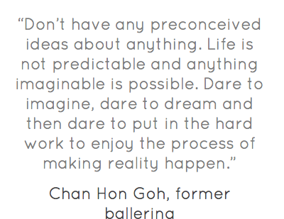

Slide 8
A job is better than starting my business
1st Preconceived idea

Slide 9
Job Vs Business
Someone (employee) that delivers services to another one, either a physical or legal one (employer), in a subordinated way, on a personal basis, recurrently and paid for.
Notes:
Que é o Negócio para voçês?

Slide 10
Job Vs Business

Slide 11
Job Vs Business
WHY?
Levels of Comfort zones (are they really comfortable?)
Financial?
Structural?
Others? Time management?
What are we missing?
Fast learning track
Impact
Power to decide our lives
Notes:
he financial comfort: we had to work hard, so we could justify our pay checks. However, our performance had an effect only on a mid to long term basis, but rarely on a short term basis. The risk was limited, and easily managed.
The process comfort: we were part of a group, an entity, and whether we were a driver or a follower, we did not have to worry night and day about the “what to do?” or the “why do this rather than that?” because it was being expressed and managed collectively.
The time management comfort: this might be the biggest challenge, because you never see the truly positive aspects of office hours until you loose them.
The combination of the three brought a whole new dimension to our professional lives, and clearly challenged our pre-conceived convictions.

Slide 12
Entrepreneurship is not for me!
2nd Preconceived idea

Slide 13
ENTREPRENEURSHIP
WHAT IS IT TO YOU?

Slide 14
ENTREPRENEURSHIP

Slide 15
Entrepreneurship
Entrepreneurship is the practice of starting new organizations or revitalizing mature organizations, particularly new businesses generally in response to identified opportunities. Entrepreneurship is often a difficult undertaking, as a vast majority of new businesses fail. Entrepreneurial activities are substantially different depending on the type of organization that is being started. Entrepreneurship ranges in scale from solo projects (even involving the entrepreneur only part-time) to major undertakings creating many job opportunities
(source: wikipedia)
Entrepreneur: the art of taking something at risk
Notes:
A largely held view of the term is that an Entrepreneur is the person who brings about a change and possesses characteristics to implement ideas to benefit the society as a whole. Only a few people are talented enough to manage this change. Apart from this definition, a simple explanation of the term ?Entrepreneurship? is that it is the person who wants to work for himself.

Slide 16
Entrepreneurship
Entrepreneurship – the pursuit of opportunity beyond the resources one currently has under control (source: Berkley, 2006)
Management process NOT only an individual characteristic

Slide 17
The Process of Entrepreneurship
Identify
Need
Solution Opportunity
Unfair advantage
Acquire
Technology rights
People Resources
Money

Slide 18
ENTREPRENEURSHIP
DO WE NEED SPECIAL PERSONALITY TRAITS?
OR
CAN THEY BE DEVELOPED?

Slide 19
Entrepreneurs
Notes:
O Empreendedorismo pode ser intra ou inter

Slide 20
ENTREPRENEURSHIP
CAN YOU NAME YOUR FAVOURITE ENTREPRENEUR?

Slide 21
TYPES OF ENTREPRENEURSHIP
INTRAPRENEURSHIP
ECONOMIC
SOCIAL
Notes:
What are they and how do they differ?
Can you name examples?
INTRAPRENEURSHIP – VINHO D’AGUA Casa Ervideira
ECONOMIC – UNIPLACES
SOCIAL - Ocean Sole

Slide 22
Startups are small companies
3rd Preconceived idea

Slide 23
STARTUP Vs SME
Are they the same?
Is a Startup a company?

Slide 24
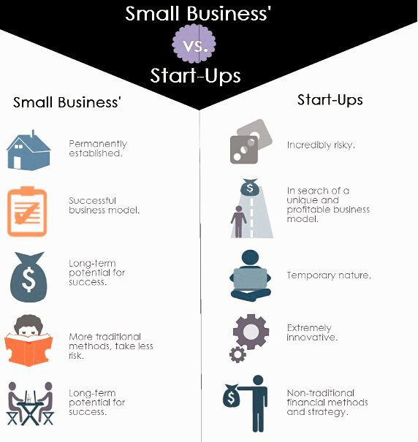

Slide 26
Innovation is just a fancy name!
4th Preconceived idea

Slide 27
INNOVATION
INVENTION
+
EXPLOITATION
=

Slide 28
INNOVATOR + ENTREPRENEUR
http://www.youtube.com/watch?v=lZKhZmvJuZY

Slide 29
INNOVATION
More detail to come next week!

Slide 30
Technology transfer is a cool technology!
5th Preconceived idea

Slide 31
Technology Transfer
Technology transfer is the process of sharing skills, knowledge, technologies, methods of manufacturing, samples of manufacturing and facilities among governments and other institutions to ensure that scientific and technological developments are accessible to a wider range of users who can then further develop and exploit the technology into new products, processes, applications, materials or services.

Slide 32
Technology Transfer
Can be done in different formats/values
Entrepreneurial (Economic Valorization)
Altruíst (Scientific Dissemination of Knowledge)
How Should we (Must we) see Science?
Notes:
Qual a Vossa precepção da ciência que fazem?
Qual a percepção que têm da percepção dos outros e do público generalista?

Slide 33
Technology Transfer

Slide 34
Technology Transfer
TTO FUNCTIONS:
Coordinate
Nurture
Link
Notes:
TT Function:
Coordinate: Coordinating between technology users and developers, between researchers and manufactures is an important element of technology transfer. Access to relevant internal and external resources to individual projects and enterprises has to be enabled.
Nurture: A main ingredient for moving technology from a research laboratory to a new business enterprise successfully is an environment that is supportive of entrepreneurship. This needs to be encouraged by providing guidance, counseling and resources.
Link: Cataloging resources related to business enterprises and connecting would-be entrepreneurs/researchers and other technology developers to outside groups and organizations which can help in the process of starting new products, companies etc. Such linkages provide referrals for individual business counseling, sources of financing or the names of individuals who can help with a particular facet of business development.

Slide 35
Technology Transfer
Constituents of Technology Transfer Processes
Technology Transfer
Technology Promotion
Technology Deployment
Technology Innovation
Technology Development
Technology Research
Technology Assessment
Technology Information and communication
Technology Investment
Technology Collaboration
Technology Commercialization

Slide 36
Does knowledge have an economic value?
K2B, I-Teams, BioTeams….
Why?
Option or Duty?
What tools are we missing?
Notes:
Performing opportunity recognition, fostering entrepreneurs, structuring deals, HARVESTING OUTCOMES! Ferramentas:
TTO education
Awareness of opportunity constant search
Dedicated office
Competitions
Learn by doing (use the student force to spread the work)
Go to meetings with potential customers/buyers/VCs
Incentives to Pis – spin-out companies
…

Slide 37
TOOLS WE NEED TO VALUE K
Management
Technical/Scientific
Other?
Atitude?
Soft Skills?
Critical analysis?
Negotiation SKills?
IP?

Slide 38
Industry & Academia are 2 worlds apart!
6th Preconceived idea

Slide 39
Industry Vs University
2 worlds apart?
Rythm?
Focus?
Competencies?

Slide 40
I have all I can when I finish my degree!
7th Preconceived idea

Slide 41
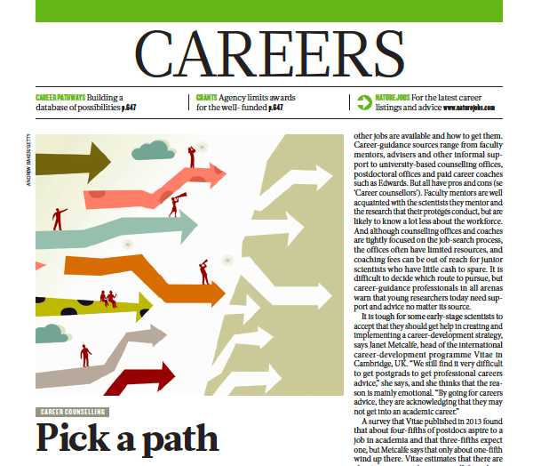
NATURE, Vol. 512, 29th January 2015

Slide 42
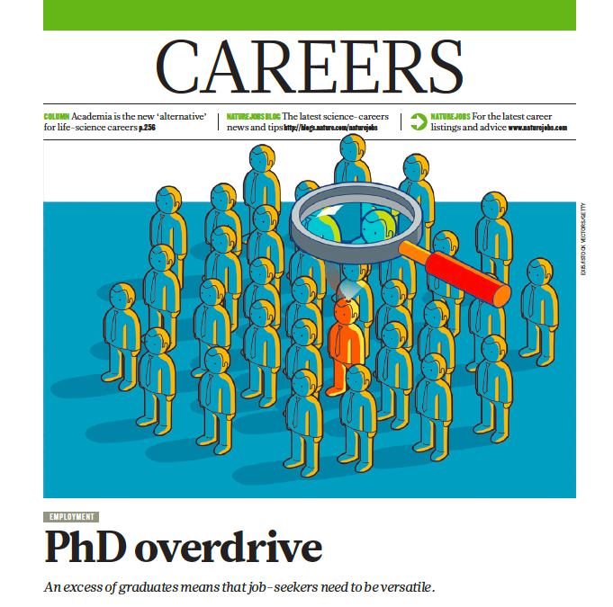
NATURE, Vol. 511, 10th July 2014

Slide 43
SOFT SKILLS = SMART SKILLS
YOU HAVE A PROBLEM:
TECHNICAL COMPETENCES DO NOT LAND YOU A JOB OR GUARANTEE SUCCESS!

Slide 44
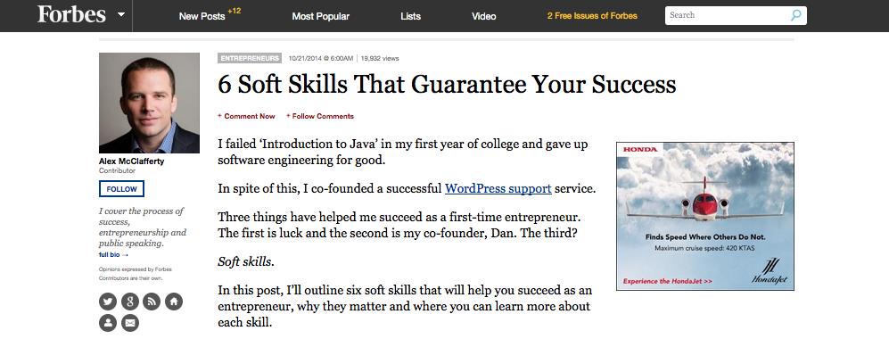
Forbes, 21 October 2014 (http://www.forbes.com/sites/alexmcclafferty/2014/10/21/soft-skills/)

Slide 45
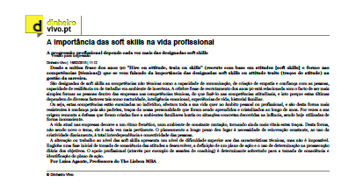
Dinheiro Vivo, 16th February 2015 (http://www.dinheirovivo.pt/Imprimir.aspx?content_id=4403566)

Slide 46
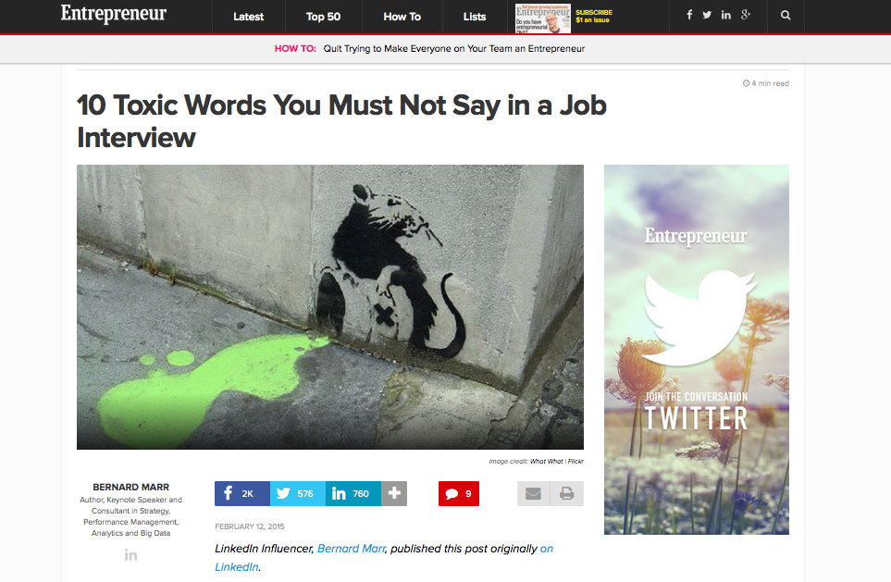
Entrepreneur, 12th February 2015 (http://www.entrepreneur.com/article/242809 )

Slide 47
SOFT SKILLS = SMART SKILLS
Major skills employers look for/successful people have:
Know how & technical competencies (25%)
Project management skills (23%)
Top verbal and written communication(15%)
Organizational skills (14%)
Interpersonal relationship skills (13%)
Resilience

Slide 48
SOFT SKILLS = SMART SKILLS
Written Communication
Verbal Communication
Different languages
Management by goals
Emotional Intelligence & Conflict management
Entrepreneurship & Failure management
Leadership and Team management
Critical analysis
Negotiation Skills
Innovation & continuous learning
Knowledge management
K2B e SWOT
K2B, Pitches & Cases
ITT/TTC/IE
ITT/TTC/IE
K2B
ITT/TTC/IE
K2B
Case Studies
ITT/TTC/IE, K2B, Cases
ITT/TTC/IE
ITT/TTC/IE

Slide 49
SOFT SKILLS = SMART SKILLS
THIS IS WHY WE WILL PUSH YOU OUT OF THE BOX, OUT OF YOUR CONFORT ZONE!
LEARNING BEGINS WHEN YOU FEEL UNCONFORTABLE…

Slide 50
Think Different

